Slide 1
LLM Image Application

Slide 2
Learning Outcomes
Upon completion of this session, the learners should be able to:
Understand the concept of text-to-image generation.
Examine real-world applications of image generation.
Develop an image generation prompt using an existing tool or API.
Explain how a Vision Language Model (VLM) turns an image into a natural-language answer.
Identify the components of a VLM and the tasks it supports (captioning, VQA, retrieval, reasoning).
Discuss the limitations and ethical risks of VLMs in practical use.

Slide 3
Introduction to Text-to-Image Generation
Foundation: Built on large multimodal foundation models trained with billions of image–text pairs using techniques like diffusion models (e.g., Stable Diffusion, DALL·E) and attention-based alignment.
Capabilities: Creates realistic visuals, edits existing images, generates variations, and adapts style or context.
Automated marketing content generation (ads, social media).
Product design & visualization (concept art, prototypes).
E-commerce personalization (dynamic product imagery).
Training data augmentation for CV/AI systems.

Slide 4
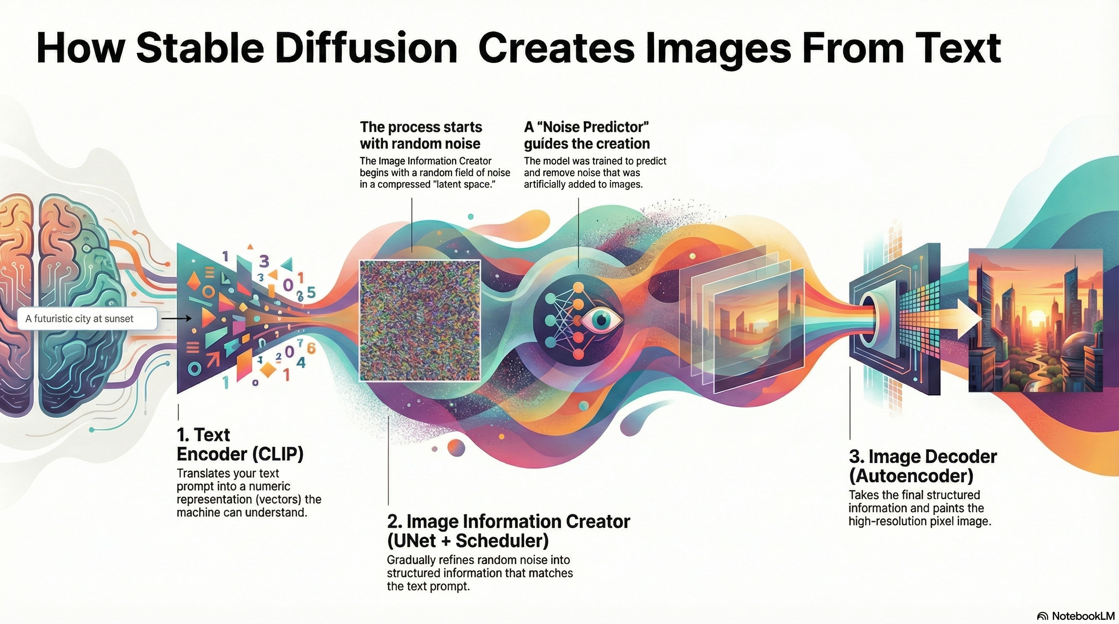
Stable Diffusion Model
https://poloclub.github.io/diffusion-explainer/

Slide 5
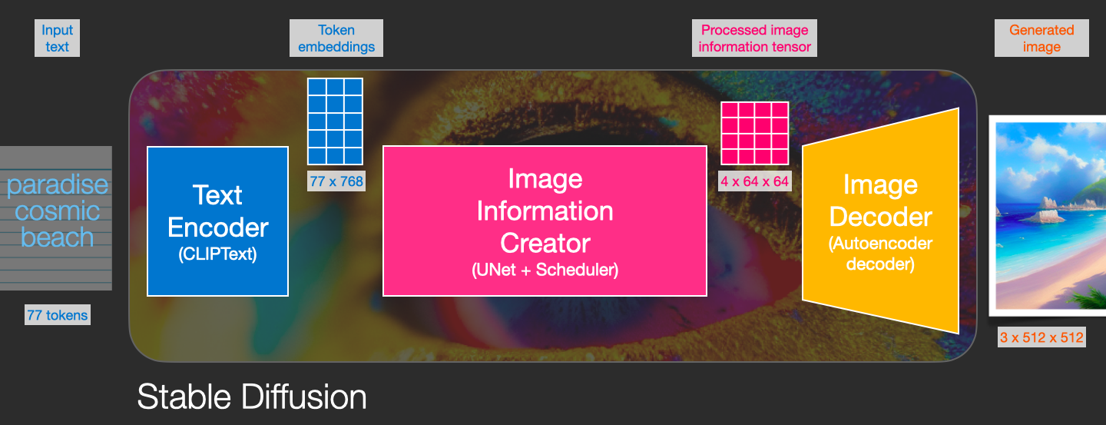
Core Technologies Behind Text to Image Generation
Transformers (CLIP) → understand text prompts.
Latent Diffusion Models (DDPM/UNet) → generate images via denoising.
VAE → efficient latent representation.
Cross-Attention → align words to image regions.
CFG Guidance → control prompt adherence.
Large-scale training datasets → foundation knowledge of concepts.
Image source: https://jalammar.github.io/illustrated-stable-diffusion/

Slide 6
Transformer-based Language Models
Text prompts must first be understood and encoded.
This uses transformer architectures (e.g., CLIP, BERT, GPT-style encoders).
The prompt is converted into embeddings → numerical vectors capturing semantic meaning.
Example:
  “A cat wearing sunglasses” → [0.21, -0.45, ...]
These embeddings condition the image generation model.
Key technology: Transformers + Embedding spaces
Source: https://openai.com/index/clip/

Slide 7
Diffusion Models (Denoising Process)
The heart of modern text-to-image generation.
Core idea: Start from random Gaussian noise, and iteratively denoise it until a meaningful image forms.
The denoising is guided by the text embeddings (prompt).
Training:
  Add noise to training images step by step.
  Train a neural net (U-Net) to reverse this process → predict the “cleaner” image at each step.
Sampling:
  At inference, start from noise and run the denoising process backward (20–50 steps).
Key technology: Denoising Diffusion Probabilistic Models (DDPM) and improvements like DDIM, DPM++ schedulers.

Slide 8
Latent Space Representation
Instead of working on raw pixels (huge computational cost), models work in a compressed latent space.
A Variational Autoencoder (VAE) is trained to:
  Encode images → compact latent representation (like a compressed version).
  Decode latents → back into high-resolution RGB images.
This drastically reduces training + inference costs.
Example:
  A 512×512 image may be represented as a 64×64 latent.
Key technology: Variational Autoencoders (VAE)

Slide 9
Cross-Attention Mechanism (Text ↔ Image Alignment)
Critical part of conditioning: How does the model “know” where to put objects described in the text?
Answer: Cross-attention layers in the U-Net.
At each denoising step, the model aligns text embeddings with image features.
Example:
  Text: “A red car on a snowy road”.
  Cross-attention ensures “red car” affects car pixels, “snowy road” affects background.
Key technology: Cross-attention layers inside diffusion models

Slide 10
U-Net Architecture (for Denoising)
The neural backbone for diffusion models is usually a U-Net CNN with attention layers.
Why U-Net?
  It captures both global structure (overall composition) and local details (textures, edges).
  Encoder → reduces dimensions (extract features).
  Decoder → rebuilds details (refine image).
  Skip connections → preserve fine-grained info.
Key technology: U-Net with attention blocks

Slide 11
Guidance Mechanisms (Prompt Control)
Diffusion models can generate arbitrary images, but guidance steers them toward the prompt.
Classifier-Free Guidance (CFG):
  Run the denoiser twice: once with prompt conditioning, once without.
  Combine results → pushes generation closer to the prompt meaning.
CFG Scale parameter controls creativity vs fidelity to text.
Key technology: Classifier-Free Guidance (CFG)

Slide 12
Training Data & Foundation Models
These models are trained on billions of text–image pairs (e.g., LAION-5B dataset).
Models learn text–image alignment by correlating captions with images.
Foundation models like Stable Diffusion are pretrained and then fine-tuned (LoRA, DreamBooth) for custom styles or subjects.
Key technology: Large-scale pretraining on text–image datasets

Slide 13
End-to-End Pipeline (Simplified)
Prompt Encoding → Transformer (CLIP encoder) → text embeddings.
Noise Initialization → Gaussian noise latent.
Diffusion Process → U-Net + cross-attention denoises step by step.
CFG Guidance → steers toward text meaning.
VAE Decode → converts latent → pixel image.
Output Image → Final 512×512+ result.

Slide 14
Applications in the Real World
Use cases:
  Advertising and marketing (e.g., Canva AI image generator).
  Game and animation design.
  Educational content and illustrations.
  Medical imaging augmentation.
  Virtual try-ons (fashion, glasses, furniture).
Case Study:
  Example: IKEA Place App + Generative AI for AR.
  Example: Using AI image generation in museums for reconstruction.

Slide 15
From Image Generation to Image Understanding
The second half of this lecture: Vision Language Models (VLMs)
TEXT → IMAGE
Generative: a prompt goes in, pixels come out.
Diffusion, U-Net, cross-attention, CFG
IMAGE → TEXT
Understanding: pixels go in, language comes out.
Vision encoder, projector, decoder-only LLM
Why it matters: both directions share the same building blocks — a transformer, an embedding space, and billions of image–text pairs. A VLM can caption, check or critique what a generator produces, and its description can become the next prompt.
Notes:
Bridge slide. Everything so far went text -> image. VLMs run the other way: image + question -> text. Same transformer machinery, opposite direction.

Slide 16
What Is a Vision Language Model (VLM)?
A VLM is a single model that accepts an image and text together, and returns text.
It joins visual perception to natural language, so the model can describe what it sees and answer questions about it in the same conversation.
Classic computer vision labels objects (“cat”, “table”). A VLM explains the scene — what is happening, where, and why it matters.
It is built by connecting a vision encoder to a large language model, then training the pair on millions of aligned image–text examples.
SEE
A vision encoder (ViT) splits the image into patches and turns them into visual tokens.
1
ALIGN
A small MLP projector maps those tokens into the language model’s embedding space.
2
EXPLAIN
The decoder-only LLM reads image + text tokens and writes the answer.
3
Content adapted from: OpenCV — “Vision Language Models” (opencv.org/vision-language-models)
Notes:
Definition slide. Stress the single-model idea: one forward pass sees the image and the question. See / align / explain is the mental model for the next slides.

Slide 17
Traditional LLM vs Vision Language Model
Aspect | Traditional LLM | Vision Language Model
Input | Text only | Images and text, together
Knowledge | Derived from text corpora | Grounded in text and visual data
Reasoning | Text-based | Multimodal — across vision and text
Example task | Write a poem about a sunset | Describe what is in this photograph
A VLM does not replace an LLM — it is an LLM with eyes attached.
Content adapted from: OpenCV — “Vision Language Models” (opencv.org/vision-language-models)
Notes:
Use the last row as the punchline: same fluency, but the answer is anchored to something the model can actually see.

Slide 18
Inside a VLM: End-to-End Architecture
Image
photo / frame / scan
Image Encoder (ViT)
patches → visual features
Vision–Language Projector
small MLP: image → text space
Shared Embedding Space
one sequence of image + text tokens (+ positional encoding)
Decoder-only LLM
generates text autoregressively
Text prompt
“What is happening here?”
Tokenizer + Embedding
tokens → text vectors
Answer in words
“Four people share a meal…”
Both modalities end up as vectors in one sequence — that is the whole trick. The LLM then attends jointly across image and text tokens.
Content adapted from: OpenCV — “Vision Language Models” (opencv.org/vision-language-models)
Notes:
Walk the two paths left to right. Key point: the projector is the only new piece; encoder and LLM are usually pre-trained and frozen at first.

Slide 19
Key Components at a Glance
Image Encoder
A Vision Transformer divides the image into patches and extracts features from each one.
Vision–Language Projector
A small multilayer perceptron (MLP) that aligns image embeddings with text embeddings.
Tokenizer & Embedding Layer
Converts the prompt into token IDs, then into dense semantic vectors.
Positional Encoding
Adds spatial and sequential information so order and location are not lost.
Shared Embedding Space
Image and text tokens become one sequence, enabling joint attention across modalities.
Decoder-only LLM
Produces the answer token by token, conditioned on the full multimodal context.
Read them in order: the first four prepare the tokens, the last two do the thinking.
Content adapted from: OpenCV — “Vision Language Models” (opencv.org/vision-language-models)
Notes:
Six components, in pipeline order. Ask the class which one is new compared with a text-only LLM (answer: encoder and projector).

Slide 20
How VLMs Are Trained
1 Contrastive pre-training
Millions of image–text pairs teach the encoder which pictures and which captions belong together (CLIP-style).
2 Alignment of modalities
The projector is trained so image embeddings land where the language model already understands meaning.
3 Instruction tuning
Curated question-and-answer data turns the pair into a conversational assistant that follows instructions.
Datasets that make this possible
LAION-5B
5B+ image–text pairs,
multilingual
PMD
~70M pairs from COCO and
Conceptual Captions
VQA
200k+ images,
five questions each
ImageNet
14M+ labelled images,
WordNet hierarchy
Content adapted from: OpenCV — “Vision Language Models” (opencv.org/vision-language-models)
Notes:
Three stages, cheapest last. Note that stage 1 is matching only; the ability to hold a conversation comes from stage 3.

Slide 21
Evolution of Vision Language Models
CLIP 2021 · OpenAI
Trained on internet image–text pairs to build a shared embedding space. Matches images to captions, but does not write them.
LLaVA 2023 · Open source
Connects a CLIP vision backbone to a strong LLM (Vicuna) through a simple fusion layer — real image conversations.
Flamingo 2022 · DeepMind
Moves from matching to generating: produces free-form text about an image, with few-shot prompting.
Today Multimodal assistants
GPT-4o, Gemini, Claude, Qwen-VL: image, text and often audio in one model, deployed at scale.
The trend: better alignment, larger language backbones and instruction data — not new image encoders.
Content adapted from: OpenCV — “Vision Language Models” (opencv.org/vision-language-models)
Notes:
Four beats: match (CLIP), generate (Flamingo), converse (LLaVA), commodity (today's assistants).

Slide 22
What VLMs Can Do: Core Tasks
Image Captioning
Generate a description of the picture.
Example: “A group of colleagues looking at a laptop in an office.”
Visual Question Answering (VQA)
Answer a specific question about the content.
Example: “How many people are at the table?” → “Four.”
Image–Text Retrieval
Search a collection with an image, text, or both.
Example: “Find the red chair that matches this photo.”
Visual Reasoning
Interpret relationships and context, not just objects.
Example: “Why might this person be smiling?”
Captioning and VQA are the demos; retrieval is the commercial workhorse.
Content adapted from: OpenCV — “Vision Language Models” (opencv.org/vision-language-models)
Notes:
Captioning and VQA are the two you will demo. Retrieval is the commercial workhorse; reasoning is where hallucination risk starts.

Slide 23
VLM Applications in the Real World
1
Accessibility — Screen readers that describe images and screenshots aloud for visually impaired users.
2
Content organisation — Auto-tagging, sorting and moderating large media libraries without manual labelling.
3
E-commerce — Product search and recommendation from a photo plus a few words of refinement.
4
Multimodal search — Search engines that combine a picture and a question in one query.
5
Documentation support — Drafting first-pass descriptions of diagrams, charts, forms and scanned documents.
Content adapted from: OpenCV — “Vision Language Models” (opencv.org/vision-language-models)
Notes:
Ask the class which of these they have already used this week. Accessibility is the strongest social case; e-commerce is the strongest commercial one.

Slide 24
Limitations & Challenges of VLMs
Model complexity
Two architectures in one make training, tuning and deployment harder.
Bias
Incorrect patterns in the training data are memorised and repeated.
Limited understanding
Strong pattern recognition is not the same as true reasoning.
Hallucination
The model can describe objects that are simply not in the image.
Poor generalisation
Accuracy drops on out-of-distribution or unseen material.
Computational cost
Substantial resources are needed to train and to serve.
Ethics: training images are often collected without informed consent, and a confident wrong answer is still wrong — keep a human in the loop for anything high-stakes.
Notes:
Mirror of the image-generation ethics slide. Emphasise hallucination: the fluent sentence hides the uncertainty.

Slide 25
Putting It Together: Generation + Understanding
Prompt
“a cat wearing sunglasses”
Diffusion model
text → image
Generated image
pixels
VLM
image → text
Caption / critique feeds back — “the sunglasses are missing” → refine the prompt
Three things to take away
• Generation and understanding are the same toolkit pointed in opposite directions.
• A VLM’s answer is only as good as its alignment — fluent text can still be wrong.
• Evaluate with your own images before trusting a VLM in a workflow.
Content adapted from: OpenCV — “Vision Language Models” (opencv.org/vision-language-models)
Notes:
Close the loop drawn on the bridge slide, then hand over to the practical: caption an image you generated earlier in the session.

Slide 26
Ethical Considerations & Limitations
Deepfakes and misinformation.
Copyright and IP issues.
Bias in image generation.
Hallucination of non-existent elements.
How do we mitigate all of the above? Watermarking, content filters and prompt guidelines.

Slide 27
References
Rombach, R. et al. (2022). High-Resolution Image Synthesis with Latent Diffusion Models Paper
Radford, A. et al. (2021). Learning Transferable Visual Models From Natural Language Supervision
Paper
https://github.com/comfyanonymous/ComfyUI
https://www.digitalocean.com/community/tutorials/understanding-ai-image-generation-models-tools-and-techniques
https://jalammar.github.io/illustrated-stable-diffusion/
https://medium.com/polo-club-of-data-science/stable-diffusion-explained-for-everyone-77b53f4f1c4
https://poloclub.github.io/diffusion-explainer/
OpenCV (2025). Vision Language Models. https://opencv.org/vision-language-models/
Liu, H. et al. (2023). Visual Instruction Tuning (LLaVA). https://llava-vl.github.io/
Alayrac, J-B. et al. (2022). Flamingo: a Visual Language Model for Few-Shot Learning

